Slide 1
3D Face Recognition Project Report
Mouqing Jin
04/11/2018
Multimedia Computing & Communication Lab

Slide 2
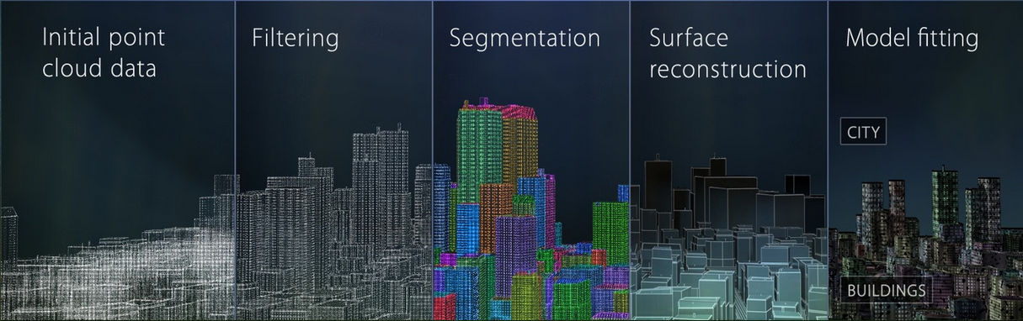
Point Cloud Library
The Point Cloud Library (PCL) is a standalone, large scale, open project for 2D/3D image and point cloud processing.
Available for Linux, Windows, and Mac OS X
Download & install: http://pointclouds.org/downloads/
Multimedia Computing & Communication Lab

Slide 3
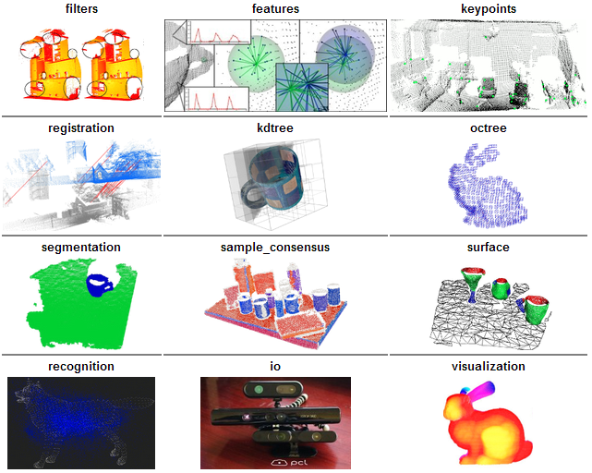
PCL modules Libraries
The most important set of released modules in PCL is shown below.
Multimedia Computing & Communication Lab

Slide 4
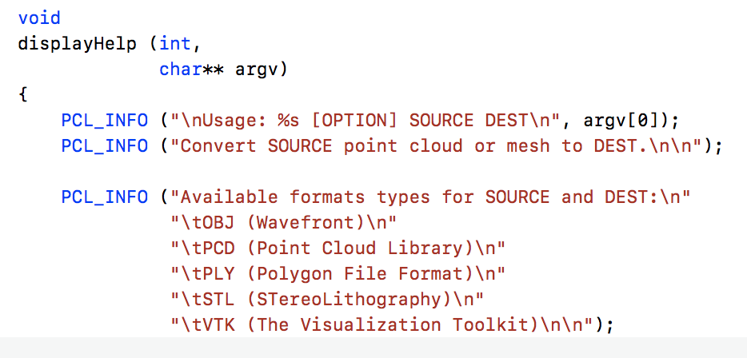
Data Representations in PCL
PCL can deal with both organized (e.g. range maps) and unorganized point clouds
Points can be XYZ, XYZ+normals, XYZI, XYZRGB, …
Both are handled by the same data structure (PCD Format type)
Multimedia Computing & Communication Lab

Slide 5
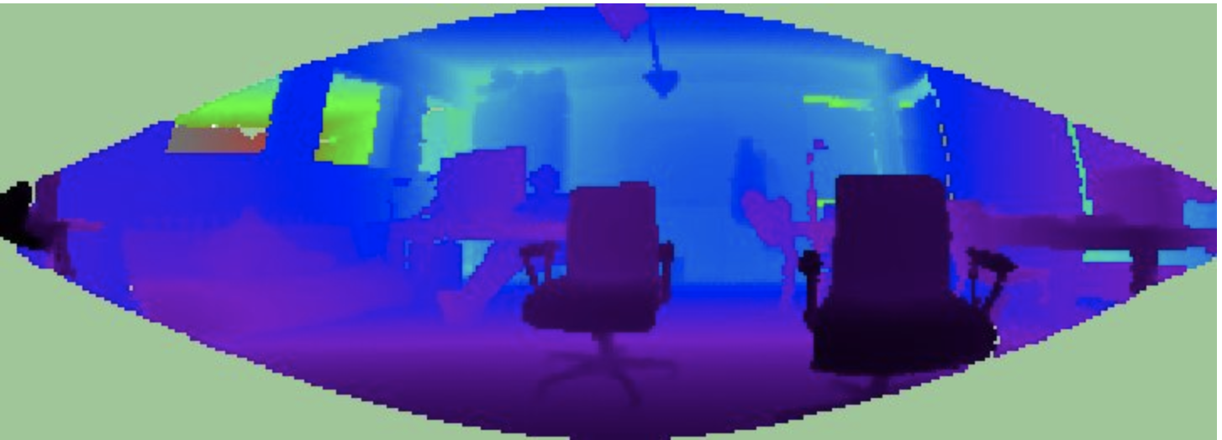
Rang image
Range images are a common 3D representation and are often generated by stereo or time-of-flight cameras. With knowledge of the camera's intrinsic calibration parameters, a range image can be converted into a point cloud
Multimedia Computing & Communication Lab

Slide 6
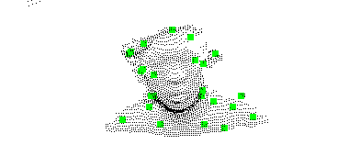
Keypoint extration
NARF (Normal Aligned Radial Feature)
The method makes explicit use of object boundary information and tries to extract the features in areas where the surface is stable but has substantial change in the vicinity.
This method has been designed with two specific goals:
the selected points are in positions where the surface is stable;
Make use of object borders.
Multimedia Computing & Communication Lab

Slide 7
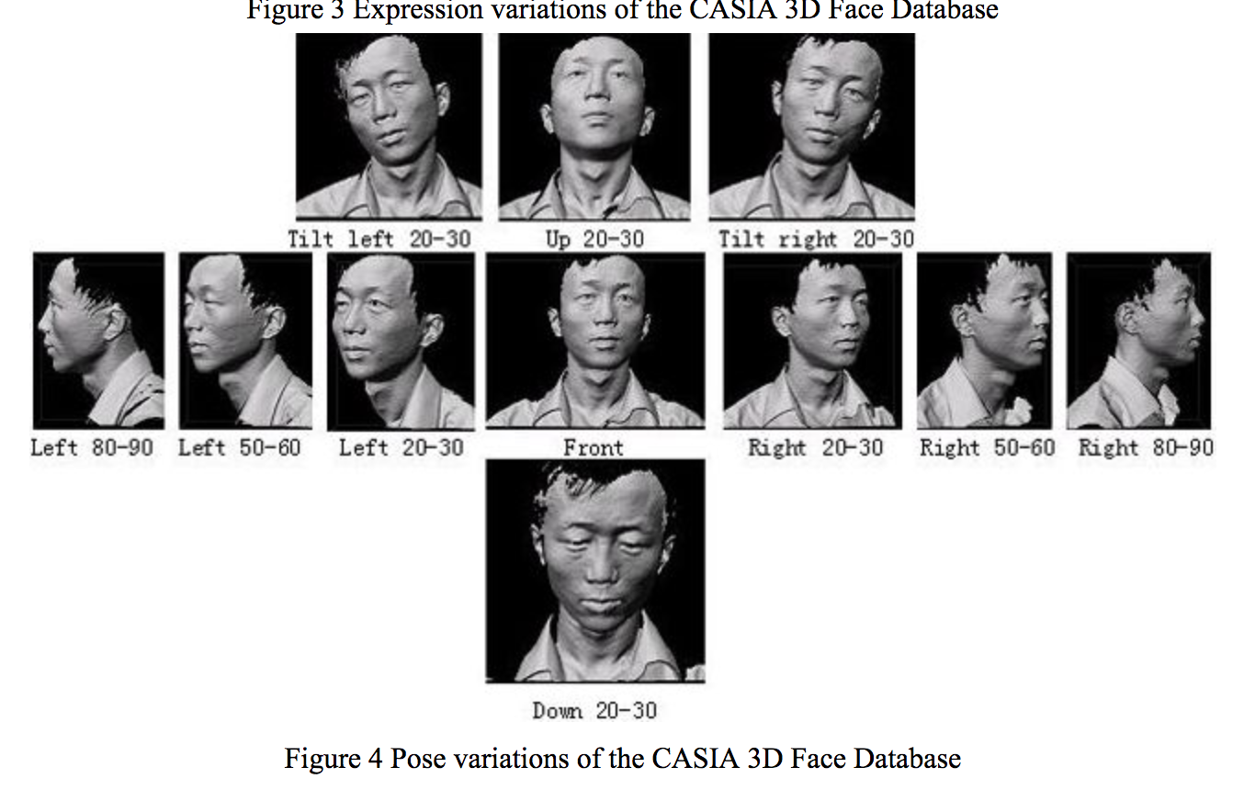
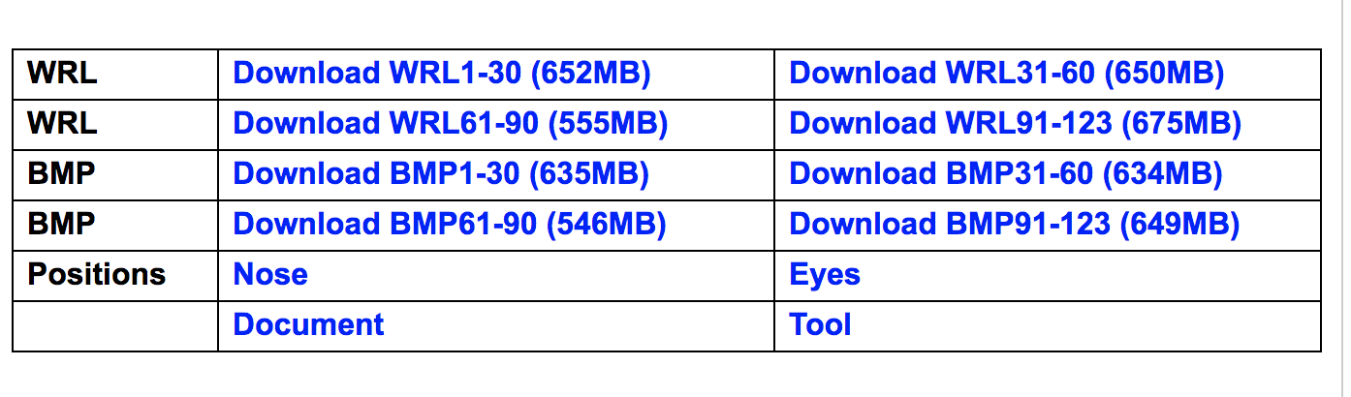
Data Collection
CASIA-3D FaceV1 Database
Download Size 4.48GB
Multimedia Computing & Communication Lab

Slide 8
Data Collection
3D Twins Expression Challenge (3D-TEC) Data Set
Data Type: Face 3D
Approximate Download Size: 1.5 GB
ND-2006 Data Set
Data Type: Face 3D
Approximate Download Size: 29 GB
Multimedia Computing & Communication Lab

Slide 9
Thank you!

